Slide 1
Peloton Usability Report
John Shpati
September 2021

Slide 2
Summary
Key Findings:
Participants were able to filter for specific classes but some felt limited by the filtering options.
When looking for an outdoor running class, participants didn’t immediately notice the Outdoor category and first checked in Running.
Bookmarking was universally understood across all participants because of their familiarity with it in other apps.
Recommendations:
Consider allowing a user to select multiple class types.
Consider moving the Outdoor class category into a filter category for running.

Slide 3
About the Study
About the Study:
The Peloton app allows you to do more than just take spin classes online. You’re able to take a number of different types of pre-recorded fitness classes on your phone. The design team would like to do exploratory research to assess the overall functionality of common types of tasks.
Objectives:
Discover overall usability and sentiments towards the Peloton mobile app.
Methodology:
The proposed methodology will be a one on one moderated usability test. Participants will download the Peloton app on their personal devices and be asked to perform several tasks.
Participants:
6 Participants
Ages 25-34
Participants that exercise regularly
Participants that use or are interested in fitness classes

Slide 4
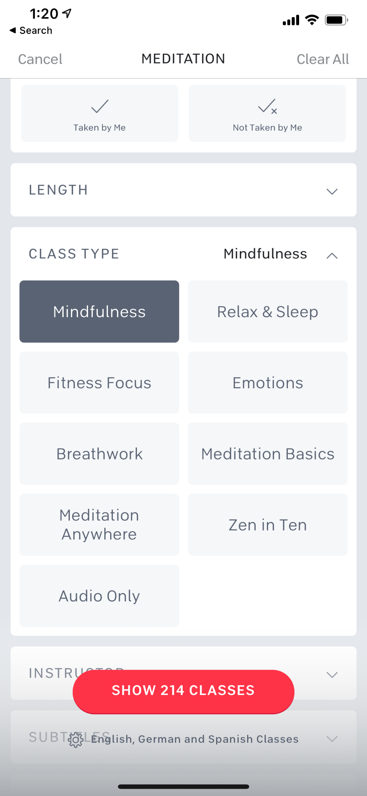
Task 1: Show me how you might find and join a meditation class that you have time for.
All participants were quickly able to find a meditation class under 20 minutes, but 2 participants expected to be able to filter for multiple class types instead of just one.
P5 “I want to see Mindfulness and Breathwork classes at the same time, instead of going in one by one”
6/6 Participants completed the task successfully.

Slide 5
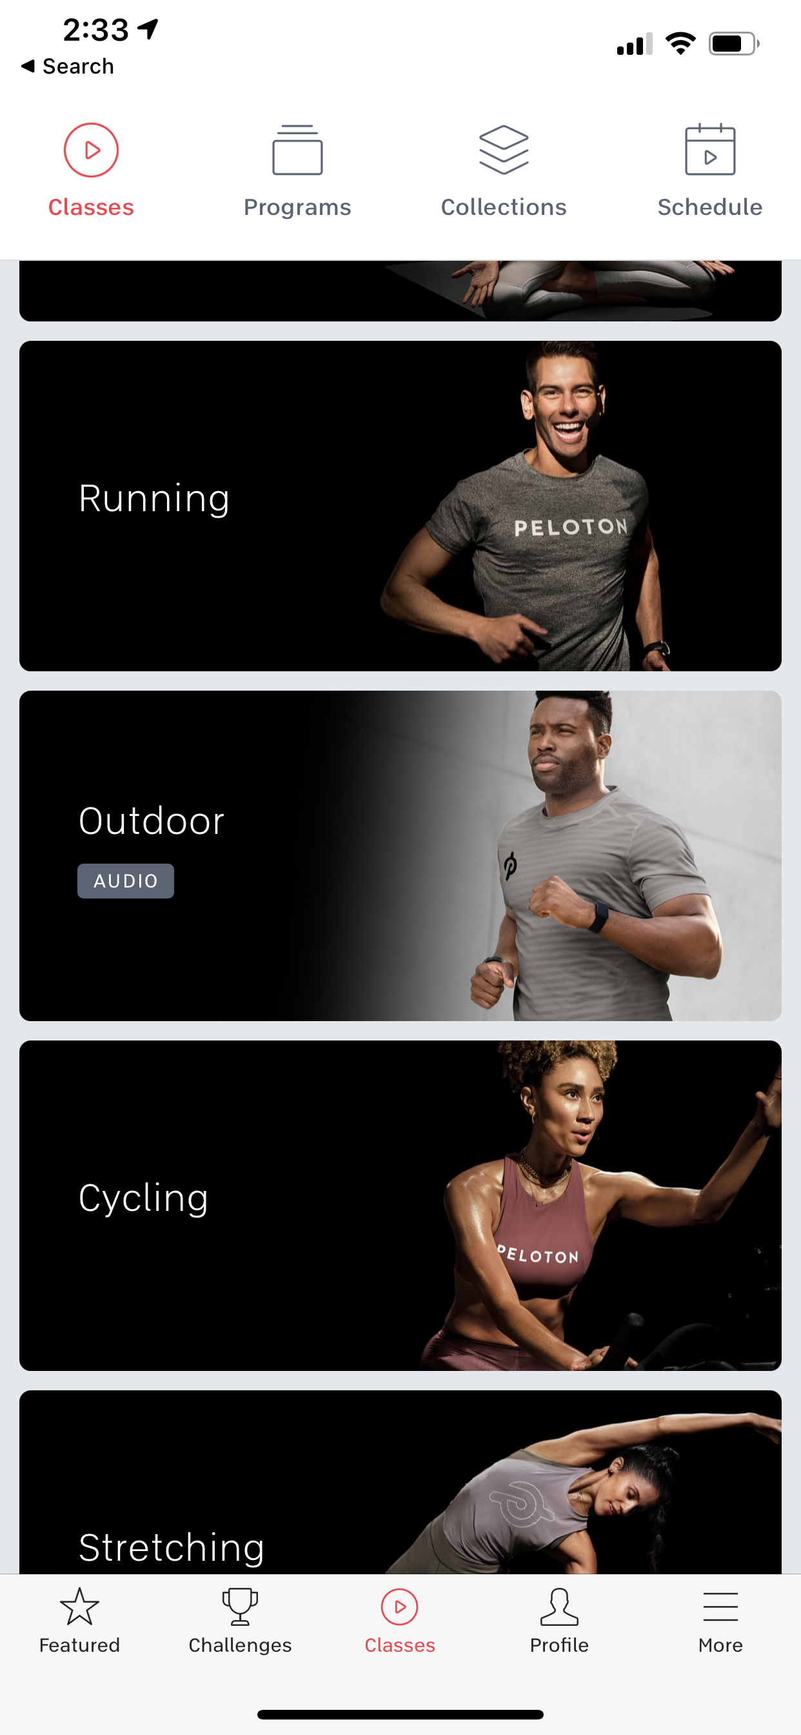
Task 2: Show me how you would start a class for running in the park.
5/6 Participants first checked Running classes before returning to the Classes page and then selecting outdoors.
P2 “That’s so confusing, why wouldn’t outdoor be an option under running”
P6 “I’d first check under running. Oh wait. I guess maybe it isn’t here”
1 Participant completed the task successfully, 5 Participants completed the task with a partial success.

Slide 6
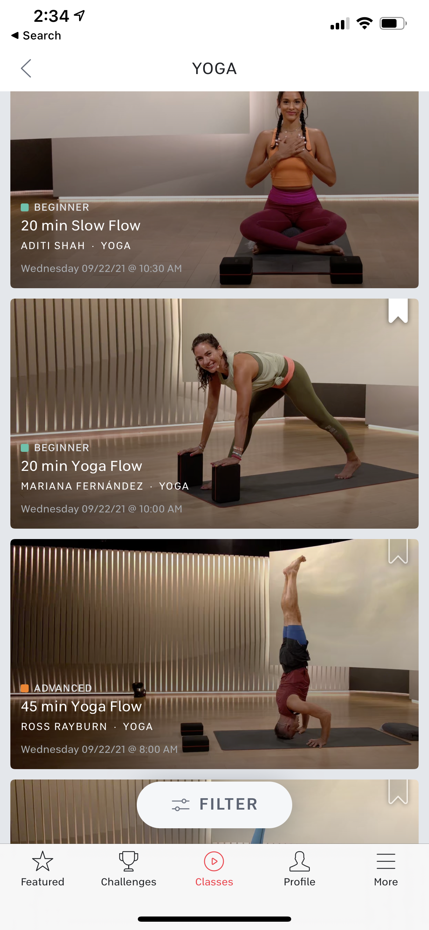
Task 3: Show me how you might find a yoga class you like and save it for later.
All 6/6 participants easily understood and recognized the bookmark button to mean that it could be saved for later.
4 participants bookmarked from the main Yoga exploration page, while the other 2 bookmarked after filtering for classes.
6/6 Participants completed the task successfully.

